Slide 1



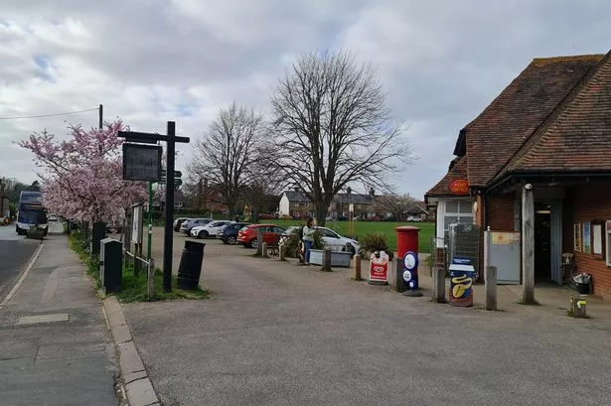
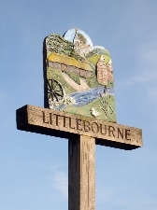
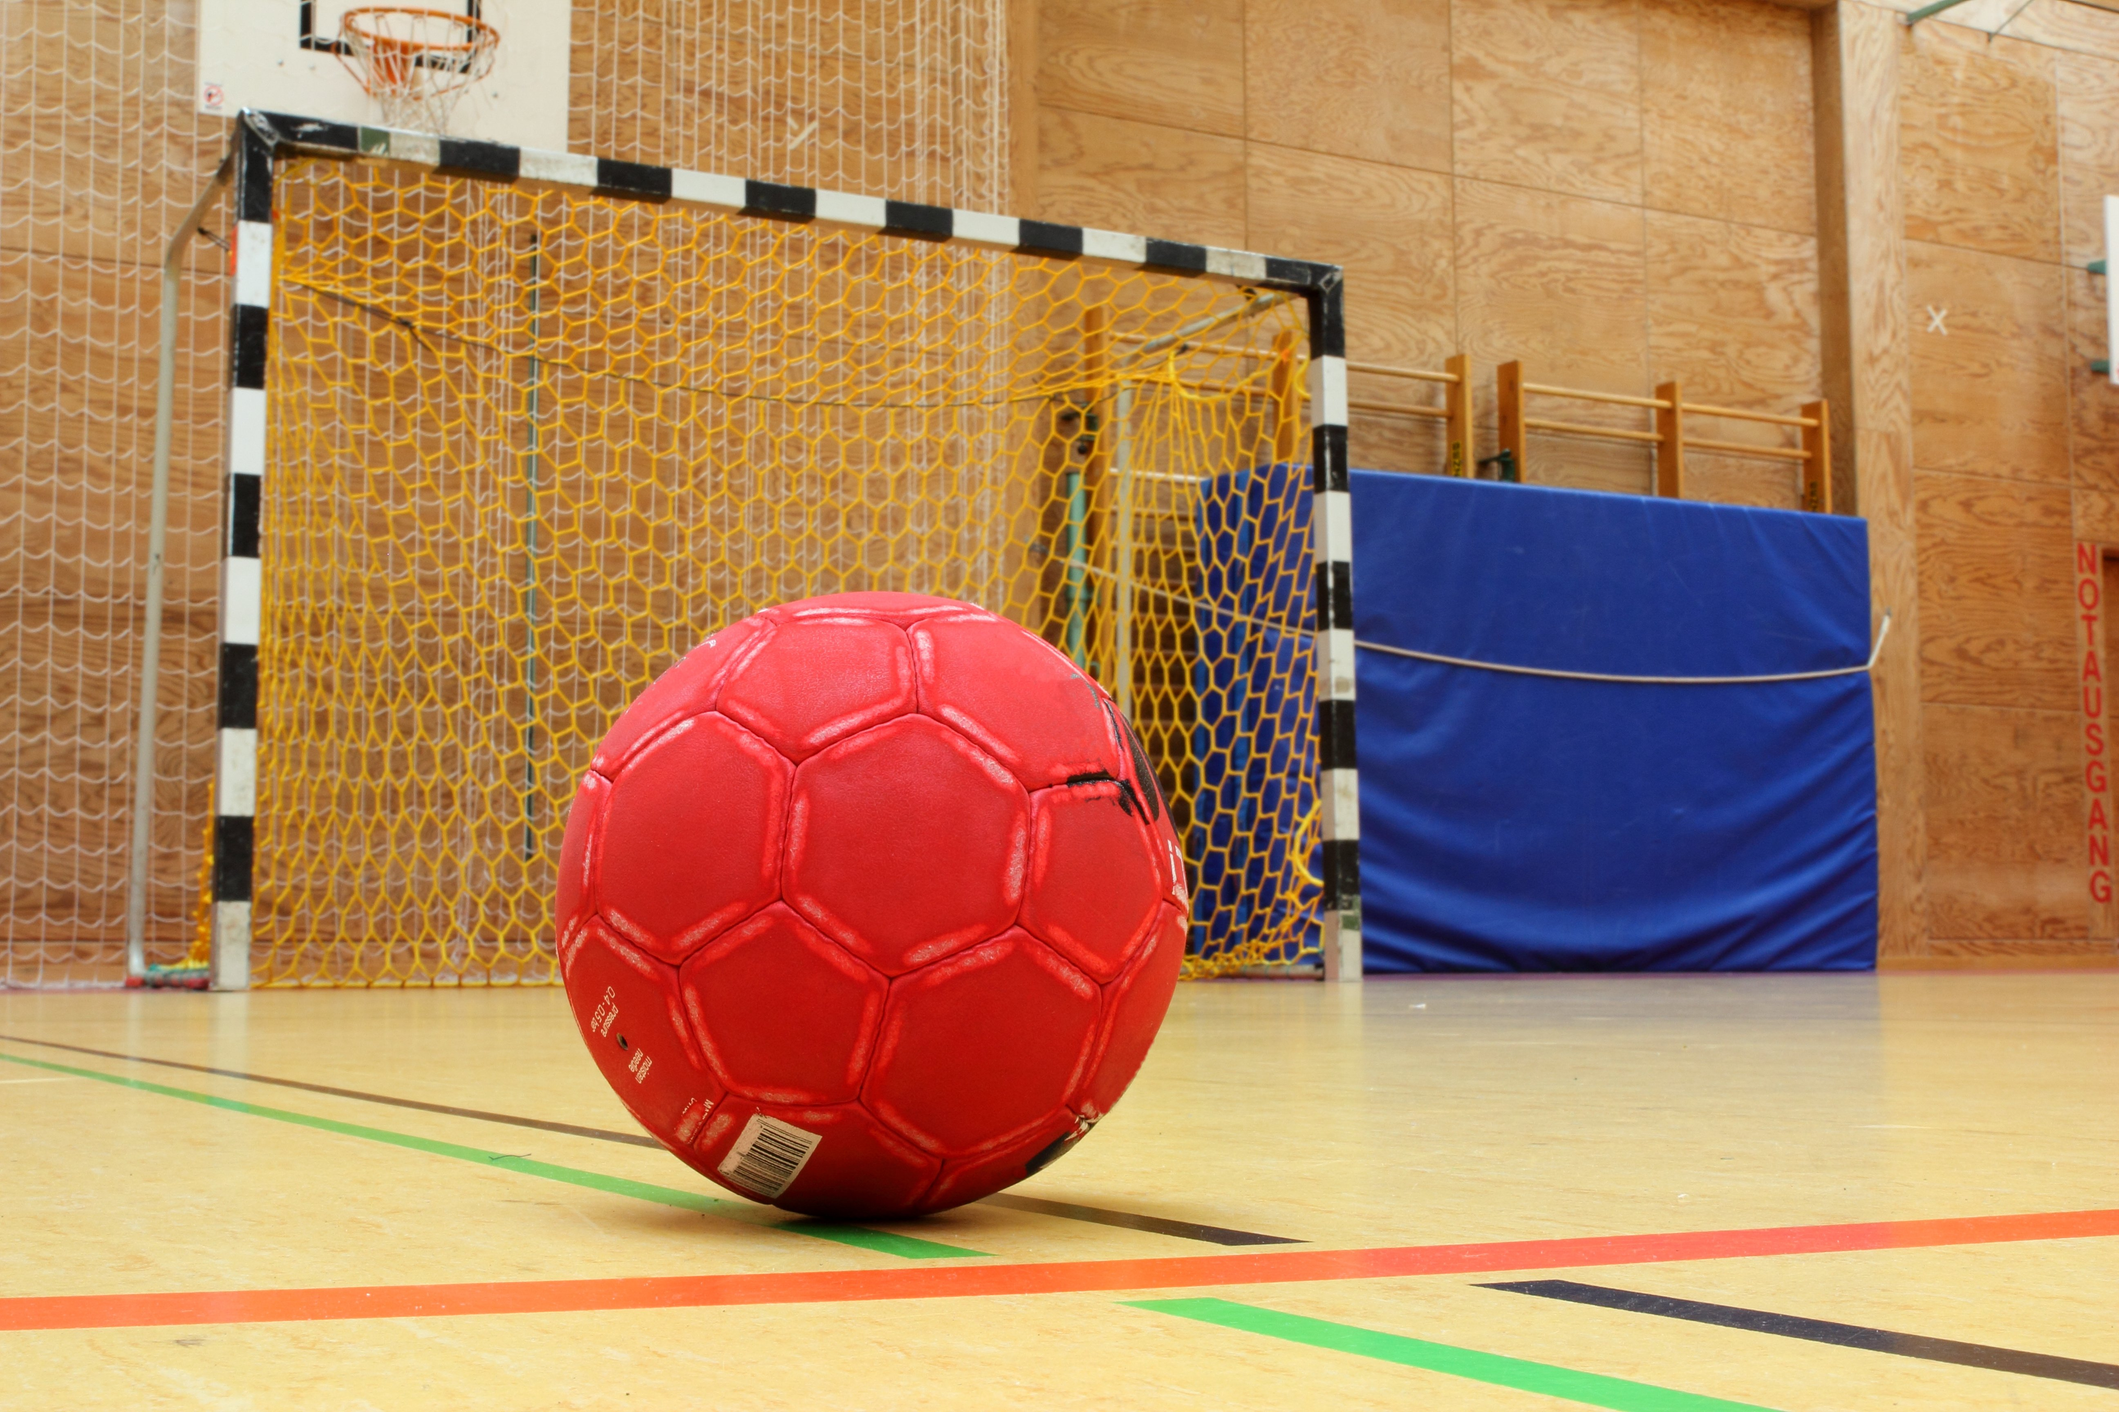

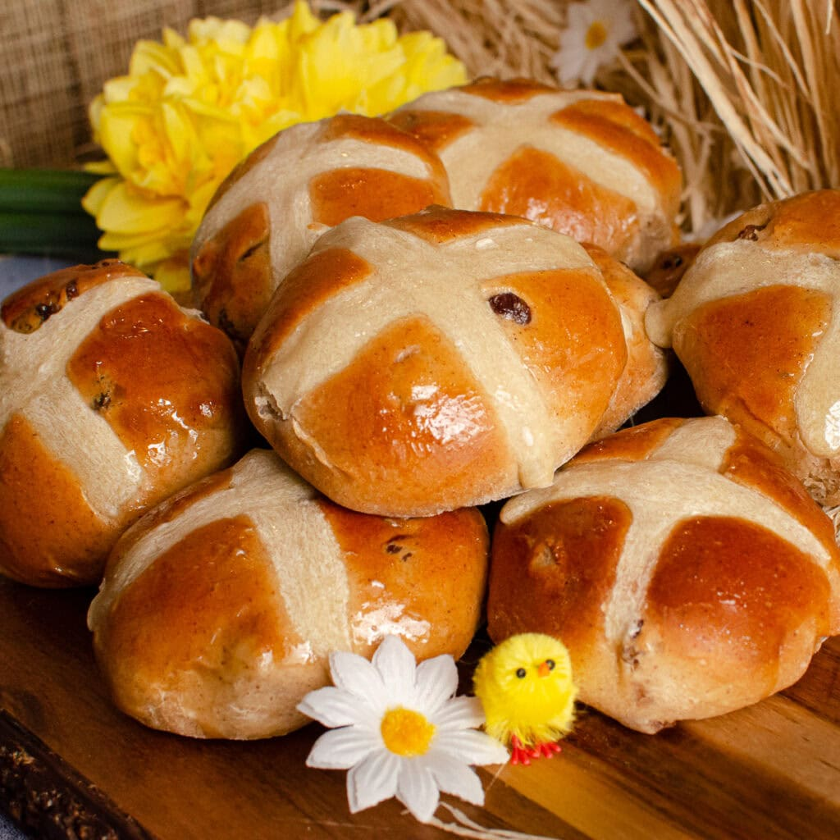
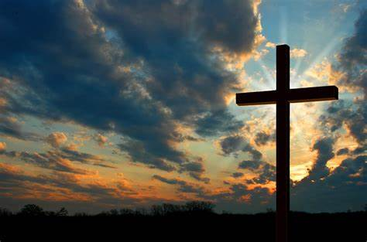
Term 4 Newsletter
Topic - Our Local Area
Our topic this term is based on Littlebourne with our focus on geography. We will be learning about our local human and physical features. We will compare how Littlebourne is different to Canterbury and consider the differences between rural and urban areas. ​
Our key vocabulary this term is; city, town, village, farm, shop, park, church, house, river, rural and urban.
English
Drawing club continues to be one of the most exciting parts of our day! Each child has unique ideas, and we have had some outstanding drawings and sentences. We have more interesting stories comping up this term, starting with…Where The Wild Things Are!
Science
In science, we will be understanding how we can group animals using their different characteristics, before also looking at the change of season from winter to spring.
Homework
Spelling homework will pause this term while we assess the children’s ability to write high frequency words correctly. This will enable us to provide accurate, individualised feedback and prepare areas for development at parent’s evening, where you will be given further spellings to work on with your child.
We will, as always, be checking reading books as regularly as possible to ensure everyone is able to work through the reading race to earn a prize.
Maths
We are going to have a big focus on maths this term, starting with our place value knowledge to 50, before moving on to multiplication and division. We are also very lucky to have an artist visiting Owls to teach maths in an exciting and creative way!
PE
Our PE days are Tuesday and Friday. This term, we will be learning how to play handball and hockey.
PLEASE NOTE
Children in Owls Class will no longer be changing in school for PE. Instead, please can children arrive at school on Tuesdays and Fridays in their PE kit, wearing school uniform as usual on the other days.
PSHE
In PSHE, we will be continuing to look at some of the aspects of healthy living including the importance of protection from the sun and who can keep us healthy. We will then discuss how to be good citizens.
RE
Our key question is; ‘Why does Easter matter to Christians?’. We’ll learn about the Easter story, link this to salvation, consider why Easter is so significant to Christians and look at the symbols of Easter.
DT
In DT this term, we will be exploring stable structures and building our own pencil pot.

