Slide 1


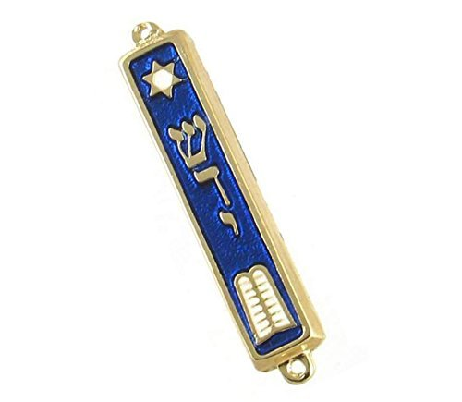
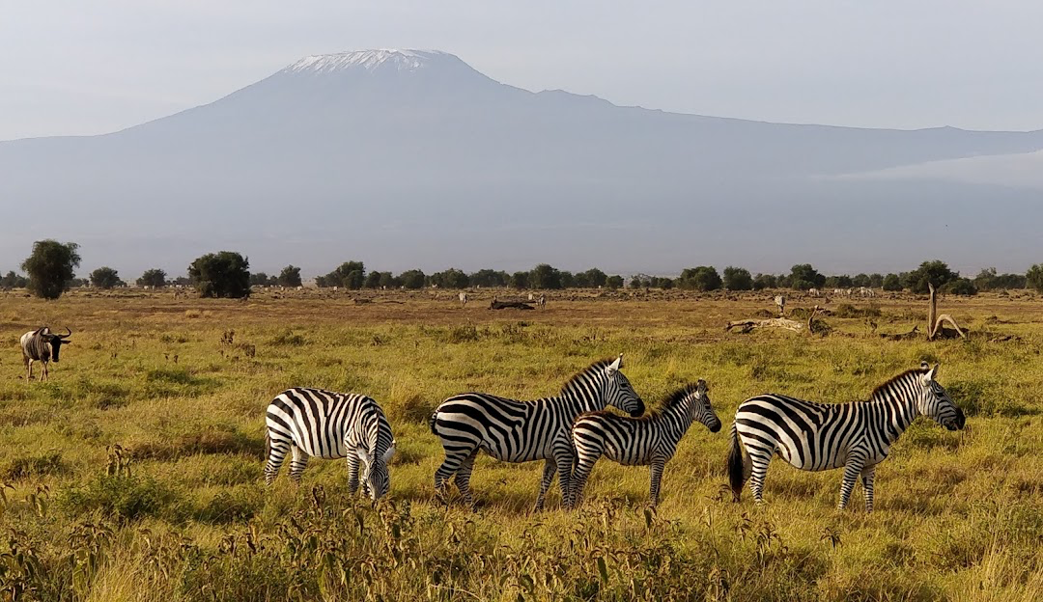

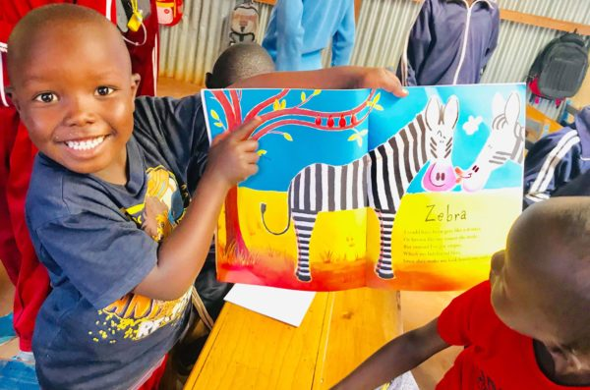
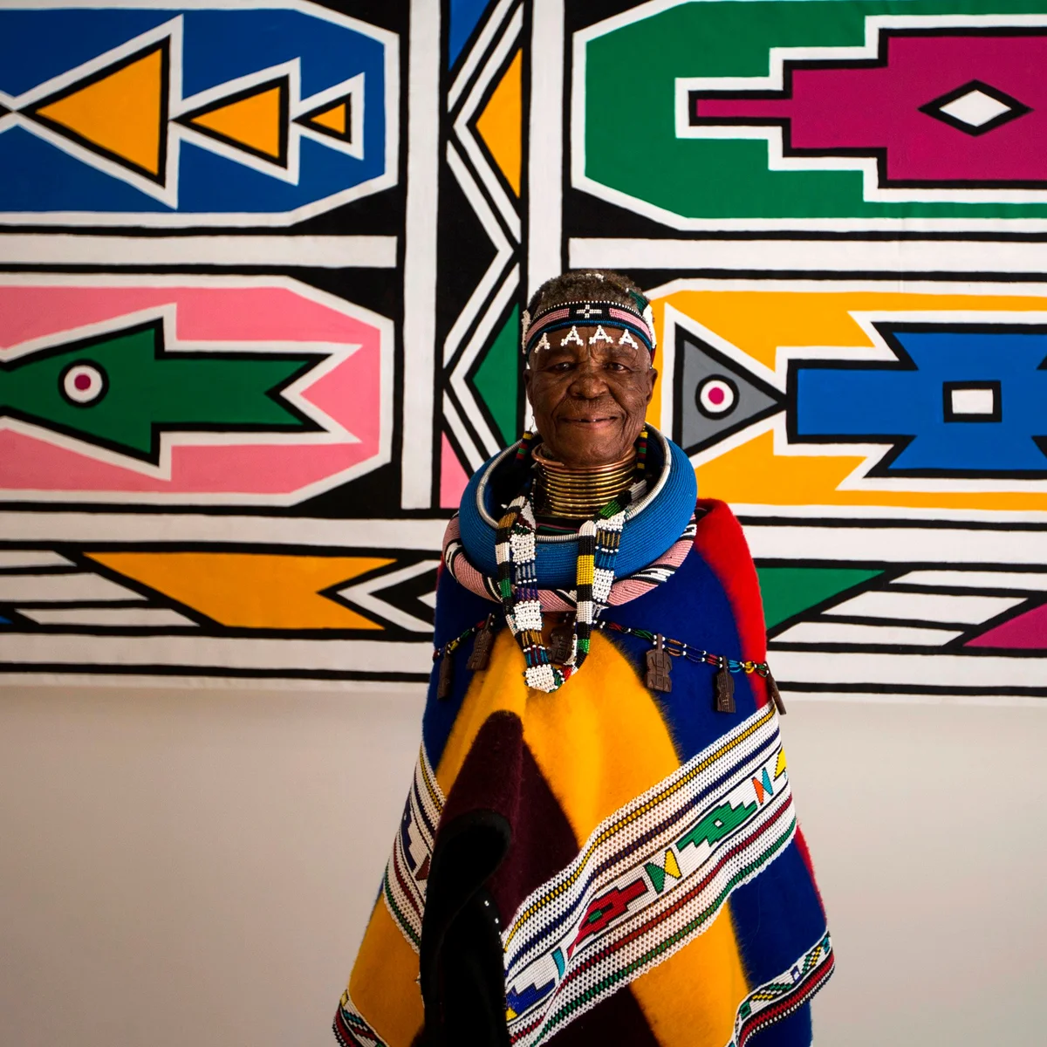


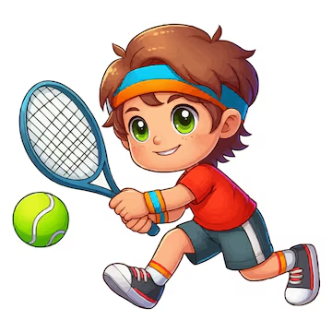

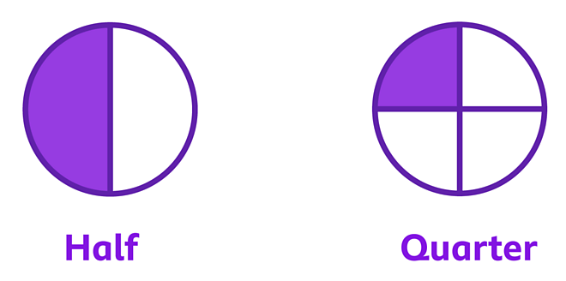
Term 5 Newsletter
Topic – Kenya Through the Keyhole
Our key question this term is; ‘What is it like to live in Kenya?’.
We will begin by exploring globes and maps to locate where Kenya is. We’ll learn about the climate in Kenya and learn about what life is like for people living in Kenya today, compared to what it’s like to live in the United Kingdom.
Our key vocabulary this term will be; climate, cliff, coast, valley, sea, ocean, land, compass, North, East, South, West, vegetation, weather, season, equator, tropical, temperature.
PSHE
In PSHE this term we are finishing our topic of citizenship, learning about the needs of others. We will then move on to economic wellbeing, focusing on what money is and how and why it is important to keep it safe.
RE
Our key question is; ‘Who is Jewish and what do they believe?’. We will learn about special objects we might find in a Jewish home and how and why Jewish people celebrate Shabbat.
Art
In art we will be looking at the work of Esther Mahlangu before creating a Kenyan sunset scene. We will experiment with paint to create a wash of colour before expanding our skills in printing.
Phonics
This is an important term for reading in Owls with us consolidating the phonics knowledge we have learnt so far this year. This will provide a good opportunity for the children in Owls to demonstrate how much they have improved by reading to you at home or when you are out and about!
PE
Our PE days remain on a Tuesday and Friday this term and we will be learning skills in cricket and tennis.
Maths
We have a varied term coming up in maths! We start by finishing our multiplication and division work, making equal groups by sharing. We then move on to learning about mass and volume before focusing on fractions at the end of term, specifically halves and quarters.
DT
This term in DT we will be making fruit smoothies!
English
This term in Drawing Club, we will be learning about some new fairy tales and stories such as ‘The Magic Porridge Pot’. The children continue to be very passionate about their drawings and writing and it is fantastic to see! This term we will be focusing on our handwriting, rereading what we’ve written to ensure it makes sense and extending our writing using conjunctions.
Homework
We will continue to check reading books as regularly as possible to ensure everyone is able to work their way up the reading tree to earn a prize. We will also send home the new QR codes for phonics screen practice each Friday. Thank you for your support with this!

