Slide 1


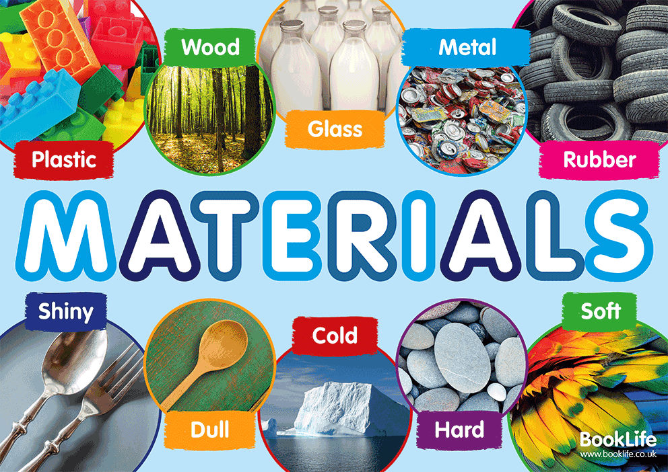



Owls Class 2025
Welcome back to school Owls! I hope you’ve had a wonderful summer and are ready to come back and learn lots of exciting things. I’m very excited about the year we have ahead of us. Our topic this term is ‘Mysterious Materials’.
Maths
In term one, we will be consolidating our place value knowledge within 10 before moving onto addition and subtraction.
At home, please do use; https://www.topmarks.co.uk/maths-games/hit-the-button to practise number bonds to 10.
Homework
Every Friday we will send home spellings that link to our Little Wandle phonics that we have been learning in class. Practise these carefully and make sure you can remember them. Please return your book by the Thursday for your new spellings to be added. We will then have a spelling quiz each Friday. Your mission is to beat or maintain your score from the week before.
Science
In science we will be learning about different materials, focussing on wood, plastic, metal and rock.
We will also be learning about the properties of different materials and conducting experiments to work out which are waterproof and which are absorbent.
Phonics and Reading
Our phonics and reading will follow the Little Wandle programme. This term we will be learning Phase 5 graphemes; ay (play), ou (cloud), oy (toy) and ea (each).
In class, we will read three times a week in groups focusing on word reading, expression and comprehension. We will also be reading 1:1 with every child regularly. Each week, a reading for pleasure book and a levelled book will be sent home and books will be checked as often as possible so the children can move along our reading race and earn a prize. Reading at home will really support your child to develop their vocabulary, understanding and open them to new worlds.
English
Our writing will be based on our text of the term; The story of Pinocchio, retold by Katie Daynes and illustrated by Mauro Evangelista. We will develop our vocabulary to create short descriptive pieces and concentrate on story telling using adjectives. We will also look to develop our sentence structure. As part of our lessons, we will also be practising our handwriting.
Computing
We will be using iLearn2 to develop our mouse and keyboard skills. Near to the end of the term, we will begin to learn to touch type.
PE
Our PE days are Tuesday and Friday. Please make sure you always bring your PE kit and have a water bottle. This term we are learning skills in football and tag rugby.
RE
Our key question for RE this term is; ‘What do Christians believe that God is like?’.
DT
In DT this term we will be making puppets.

