Slide 1
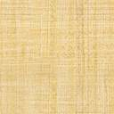


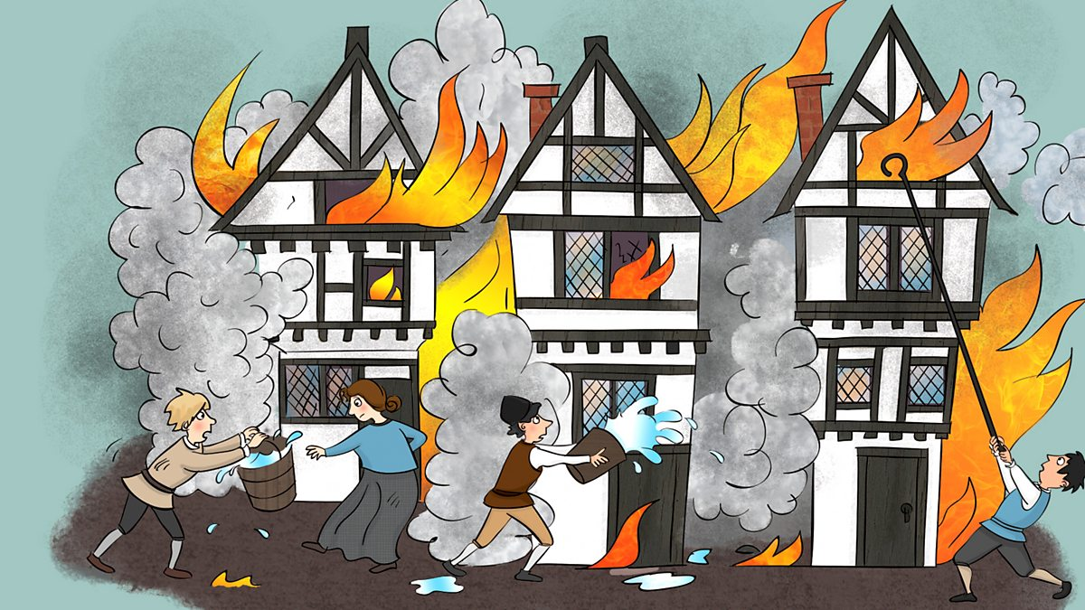

Owls Class 2025
Welcome back after half-term! I hope you’ve had a well-earned and restful break and are ready for lots of new and exciting learning. I’ve been so proud of all of your progress so far, so keep it up!
History
In history, we will be learning about the Great Fire of London. We will be looking at what London was like at the time of the fire and how it is different to today. We will also be learning about how the fire started, how it was put out and the impact it had.
Our artwork will be based around The Great Fire of London too, using different materials to create the shape and movement of flames.
Maths
This term, we will be learning strategies to solve addition and subtraction problems within 10 before moving on to identifying and naming 2-D and 3-D shapes.
At home, please do use; https://www.topmarks.co.uk/maths-games/hit-the-button to practice number bonds to 10.
Homework
Every Friday, we will send home spellings that link to our Little Wandle phonics that we have been learning in class. Practise these carefully and make sure you can remember them. We will then have a spelling quiz each Friday. Your mission is to beat or maintain your score from the week before.
Drawing Club
We have some exciting stories lined up for Drawing Club this term! It has been amazing to see how enthusiastic everyone is about their pictures and it’ll be exciting to see where our imagination takes us this term. We will continue to work on our letter formation and handwriting and on using our phonic knowledge to support our spelling.
Phonics and Reading
Our phonics and reading will continue to follow the Little Wandle programme. This term we will be learning alternative Phase 5 graphemes and split digraphs. For example; ir (bird), ie (pie), ue (blue), a-e (make), i-e (time) and o-e (home).
In class, we will read in groups, focusing on word reading, expression and comprehension. Home reading books will be checked regularly as per last term so that everyone can move through our reading race!
Computing
In computing, we will be continuing to practice our mouse and keyboard skills, learning how to double click and working on our touch typing.
Science
In science, we will be conducting an experiment to work out the best material to use for a waterproof hat for Miss Hooty as we conclude our materials topic before we move on to look at seasonal changes and differences in our daylight hours.
RE
In RE, our focus is ‘Why does Christmas matter to Christians?’. We will learn the story of Jesus’ birth, why it is important to Christians and we will look at ways in which Christians use the story of the nativity to guide their beliefs. We will also consider what we feel thankful for at this time of year and look at how the church changes at Christmas time.
PE
Our PE days remain the same as last term: Tuesday and Friday. This term we will be focussing on basketball and fitness

