Slide 1

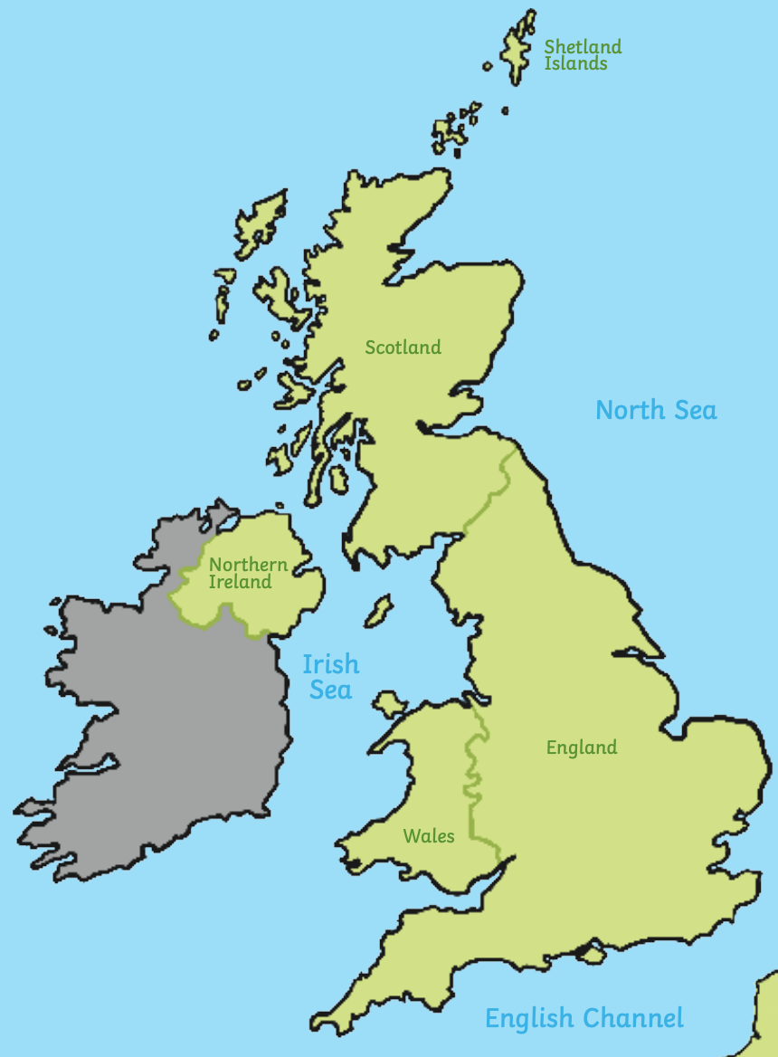



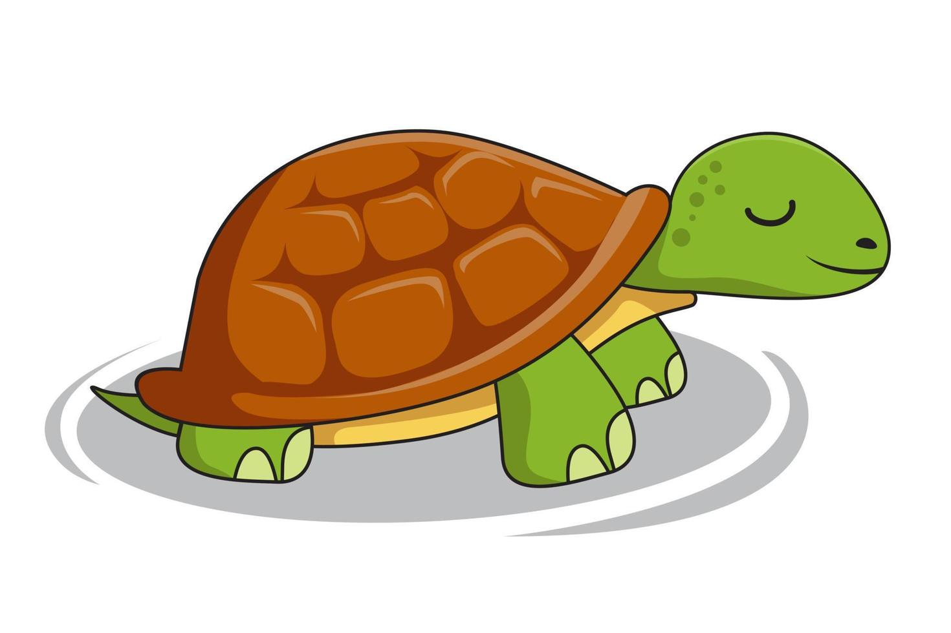


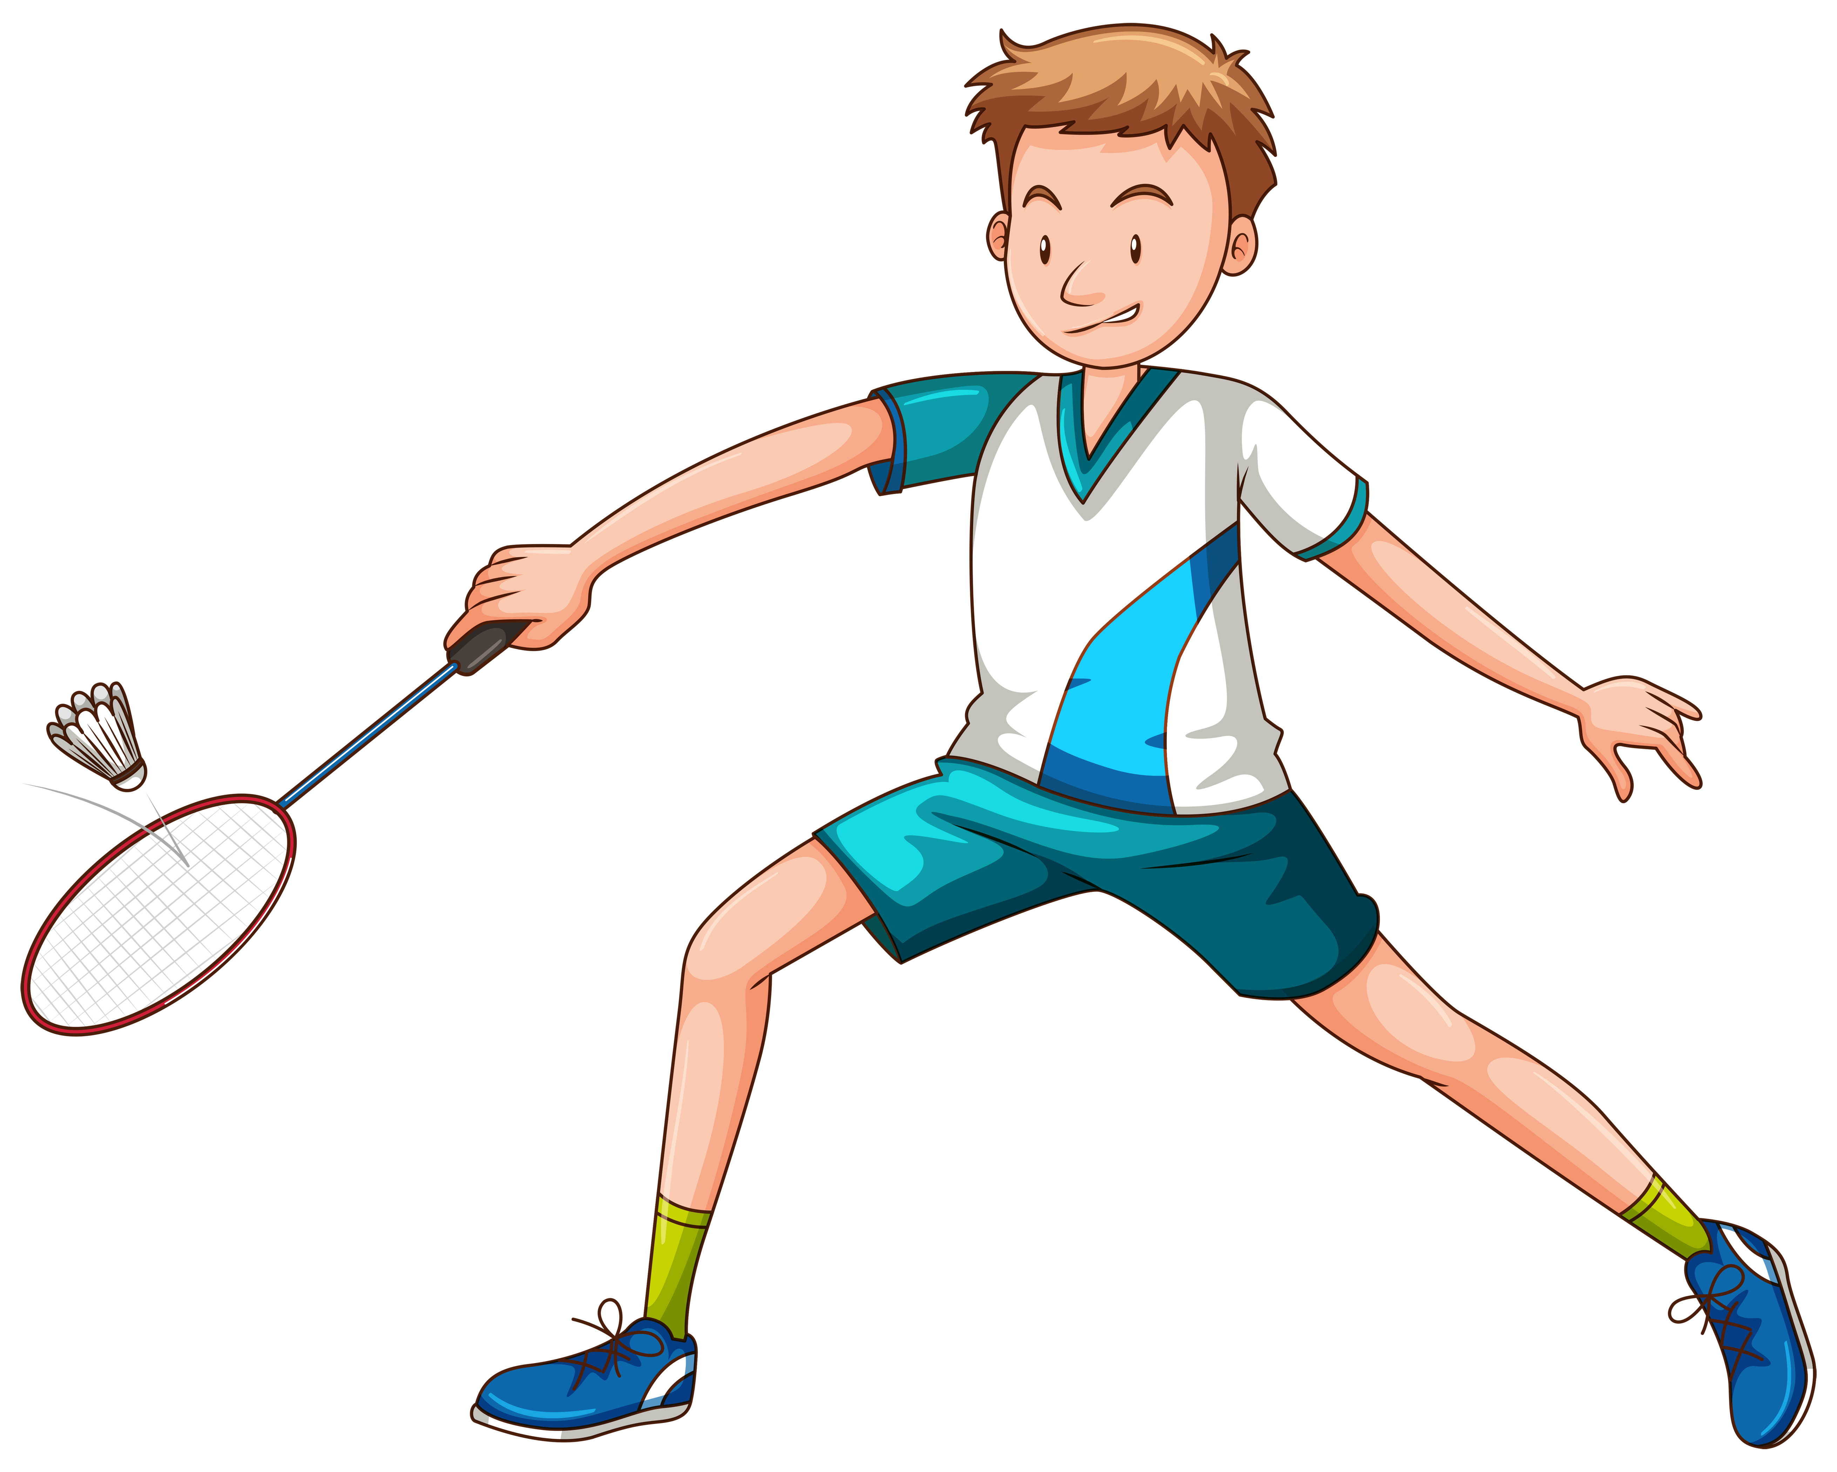
Owls Class
Phonics and Reading
Our phonics and reading will continue to follow the Little Wandle programme. This term we will be learning alternative Phase 5 graphemes. In class, we will read three times a week, in groups, focusing on word reading, expression and comprehension. Home reading books will be checked regularly as per last term so that everyone can move through our reading race! Reading is vital, so do keep practising reading at home!
Happy New Year, Owls! I’m very excited to continue our learning journey together as you continue to become caring and curious members of members of our school.
Topic – How is the UK made up?
Our focus this term is Geography. We’ll be using maps and atlases to locate the United Kingdom and learn about the countries within it. We’ll learn the capital cities of the UK, the surrounding seas and the flags and emblems of each of the countries.
Our key vocabulary this term is; England, Scotland, Wales, Northern Ireland, Irish Sea, English Channel, North Sea, Belfast, London, Edinburgh, Cardiff.
Maths
This term, we will continue learning to identify and name 2-D and 3-D shapes and their properties before moving into place value and addition and subtraction within 20.
At home, please do use; https://www.topmarks.co.uk/maths-games/hit-the-button to practise number bonds to 10 and the 2, 5 and 10 times tables.
Homework
Every Friday we will send home spellings that link to our Little Wandle phonics that we have been learning in class. Practise these carefully and make sure you can remember them. Please return your book by Thursday for your new spellings to be added. We will then have a spelling quiz each Friday. Your mission is to beat or maintain your score from the week before.
Science
In science, we will be identifying different types of animals and whether they are carnivores, herbivores or omnivores. We will also be looking at the basic parts of the human body and how they are linked to the senses.
PE
Our PE days are Tuesday and Friday. This term, we will be learning how to play badminton and practising our dance skills.
RE
Our key question is; ‘What is the good news Jesus brings?’. We will learn the story of Matthew the tax collector and consider what the text means before thinking about how Christians show kindness and forgiveness.
Drawing Club
We have some new exciting stories lined up for Drawing Club this term! The effort and enthusiasm that everyone puts into their pictures and writing continues to astound us all! We will continue to work on our letter formation and handwriting and on using our phonic knowledge to support our spelling.
PSHE
In PSHE we will be looking at understanding our emotions and the importance of relaxation and of personal hygiene, in particular, washing our hands.

